Slide 1
Notifications
Login page
Record completed deliveries with proof
Staff page
status
Delays
Customer home page
Manage customer profile
Record failed delivery attempts
Parcel collection
Send notification
Customer support
Parcel delivery
Rate the service
Select time and date
Select time and date
cancel
send
Parcel tracking
cancel
Use rate calulator
Exit system will be available from each page

Slide 2
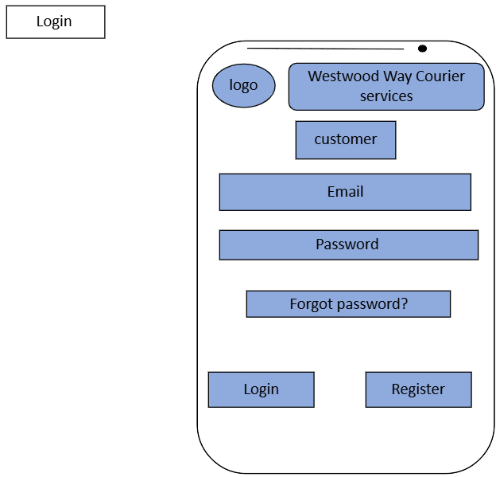
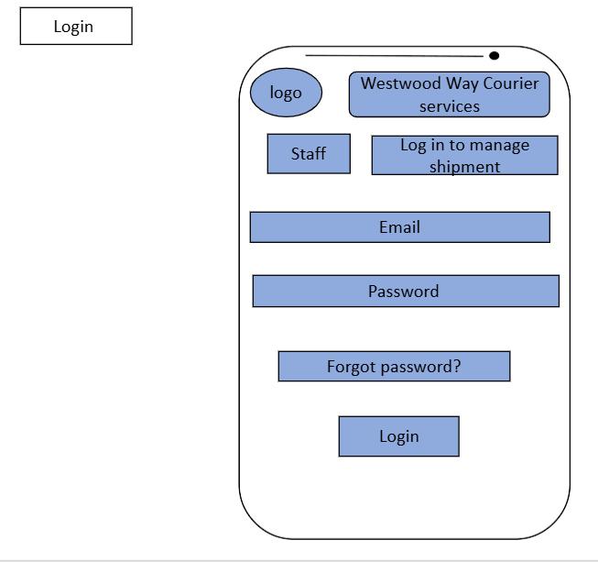
Name of the company
Brand identity which makes the customers recognize the app
Staff page
Customer page
Users and staff input their email in order to log in
Title which is directed to the staff's role
Users and staff input their password to enter their account
Users and staff can reset their password if they can not remember it
Takes users and staff to the homepage if their details are correct
If the user does not have an account it will take the user to the register page where they are made to create an account.

Slide 3
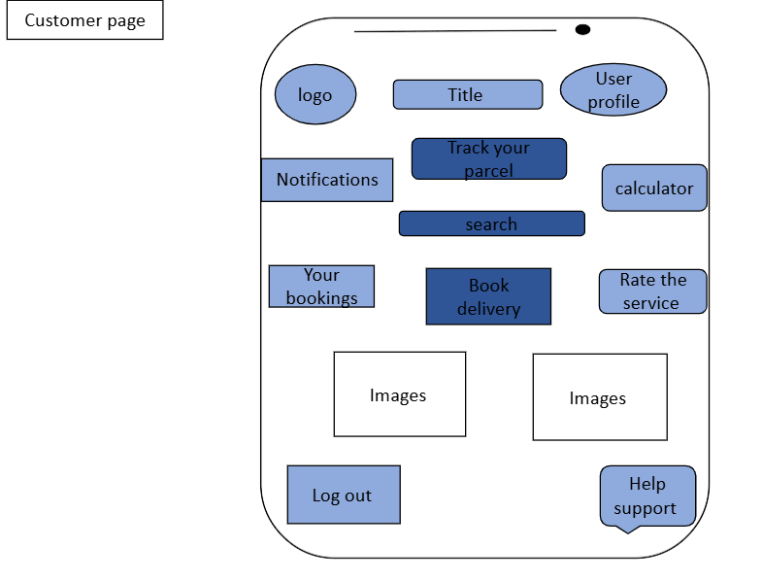
Shows the user the name of the company
User profile where they can store and edit their information
Tracking parcel which will take the user to a map where they can see where their parcel is and any updates about where their parcel has arrived.
Brand identity to make it recognizable to the user
Calculator page where the user can weigh and measure their parcel to calculate the price.
Takes the user to the notfication page where they receive updates of their parcel and any important messages from the courier
Allows user to access any tabs in a much faster way
Booking page which takes the user to where all their booking they’ve made are stored.
A mini pop up where the user can rate the service in order for the company to gather feedback and improve reputation.
Promotion images to attract more customers and make it more aesthetically pleasing
Book delivery which takes the user to the booking page.
Where the users can exist out their account
Help page where the user is taken to a chat box where they can ask any questions and communicate with the company.

Slide 4
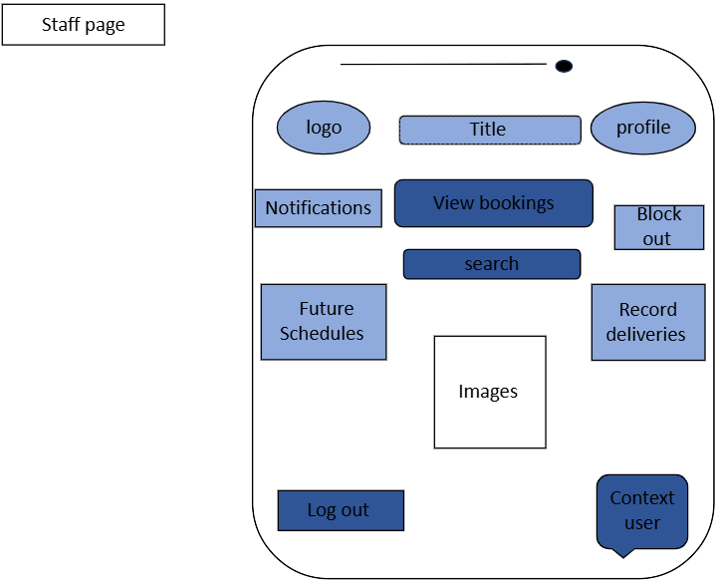
name of the company
Staff profile where they can store and edit their information
Brand identity
Booking page which takes the staff to where all their booking they’ve made are stored.
Takes the staff to the notfication page where they can send out notfications when a parcel is out for delivery.
Takes the staff to the block out page where they can remove any bookings that they are not available for.
Schedule page which takes the staff to a Callender where they can check for any future bookings and availability.
Allows staff to access any tabs in a much faster way
Staff is taken to a page where they can store and record any failed delivery attempts as well as record completed deliveries with proof of delivery.
Promotion images to make it more aesthetically pleasing
Where the staff can exist out their account
Help page where the user is taken to a chat box where they can ask any questions and communicate with the company.

